Slide 1
KISHORE S
PLAYSTORE APP REVIEW ANALYSIS
3/21/2024 Annual Review

Slide 2
PROJECT TITLE
A Deep Dive into Google Play Store App Reviews
3/21/2024 Annual Review

Slide 3


OUTLINE
PROBLEM STATEMENT
PROJECT OVERVIEW
WHO ARE THE END USERS?
YOUR SOLUTION AND ITS VALUE PROPOSITION
ALGORITHM & DEPLOYMENT
MODELLING
RESULT
CONCLUSION
FUTURE SCOPE
REFERENCES
3/21/2024 Annual Review

Slide 4
PROBLEM STATEMENT
“Developing a robust framework for analyzing Play Store app reviews to extract actionable insights and drive continuous app improvement”
3/21/2024 Annual Review

Slide 5
PROJECT OVERVIEW
The Play Store App Review Analysis project aims to leverage the vast dataset of app reviews to uncover key factors driving app engagement and success on the Android platform.
By extracting actionable insights from the reviews data, developers can make informed decisions to capture the market and enhance their app's performance, ultimately leading to greater success in the competitive app-making business.
3/21/2024 Annual Review

Slide 6

WHO ARE THE END USERS?
End users of the Play Store app review analysis project are developers and app-making businesses seeking actionable insights to enhance their apps' engagement and success on the Android platform.
YOUR SOLUTION AND ITS VALUE PROPOSITION
Our solution provides developers and app-making businesses with a systematic framework for analyzing Play Store app reviews, leveraging sentiment analysis, topic modeling, and data visualization techniques.
By extracting actionable insights from the data, we enable developers to make informed decisions, enhance app performance, and capture the Android market, ultimately driving greater success and user engagement.
3/21/2024 Annual Review

Slide 7
ALGORITHM & DEPLOYMENT
Data Input:
  Input data includes two datasets: one containing app attributes such as category, rating, size, etc., and another containing customer reviews of Android apps.
Preprocessing:
  Clean the datasets by handling missing values, removing duplicates, and formatting the data for analysis.
  Merge the datasets based on common identifiers (e.g., app ID) to combine app attributes with corresponding customer reviews.
Feature Engineering:
  Extract features from the merged dataset, such as average rating, review count, sentiment scores, and topic distributions derived from customer reviews.
  Transform categorical variables into numerical representations using techniques like one-hot encoding.
3/21/2024 Annual Review

Slide 8
ALGORITHM & DEPLOYMENT – CONT.
4.Training Process:
  Split the dataset into training and testing sets.
  Utilize machine learning algorithms such as regression or classification to train models that predict app engagement or success metrics (e.g., number of downloads, user ratings).
  Train the models using features derived from the app attributes and customer reviews data.
5.Prediction Process:
  Use the trained models to make predictions on new or unseen data.
  Input new app attributes and customer reviews into the trained models to predict app engagement or success metrics for those apps..

Slide 9
ALGORITHM & DEPLOYMENT – CONT.
6.Evaluation:
  Evaluate the performance of the trained models using metrics like Mean Absolute Error (MAE), Mean Squared Error (MSE), or accuracy (for classification tasks) on the testing set.
  Fine-tune the models or experiment with different algorithms to improve prediction accuracy.
7.Deployment:
  Deploy the trained models and analysis pipeline using cloud services for scalability and efficiency.
  Provide an interface or dashboard for developers to input app attributes and receive predictions on app engagement or success metrics, along with actionable insights derived from the analysis

Slide 10
MODELLING
Feature Selection: Utilize app attributes such as category, rating, size, etc., along with sentiment scores and topic distributions derived from customer reviews.
Regression Modeling: Develop regression models to predict app engagement metrics like the number of downloads or user ratings based on the selected features.
Classification Modeling: Employ classification models to categorize apps into success tiers (e.g., low, medium, high) based on their predicted engagement metrics.
Model Evaluation: Evaluate the performance of the regression and classification models using appropriate metrics like Mean Absolute Error (MAE), Mean Squared Error (MSE), or accuracy.
Insights Generation: Analyze the models' results to derive actionable insights for developers to enhance app performance and capture a larger share of the Android market.
3/21/2024 Annual Review

Slide 11
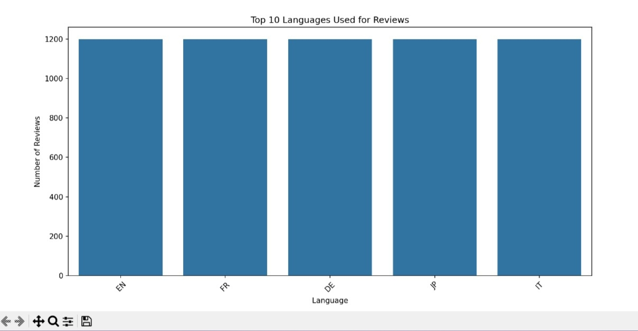
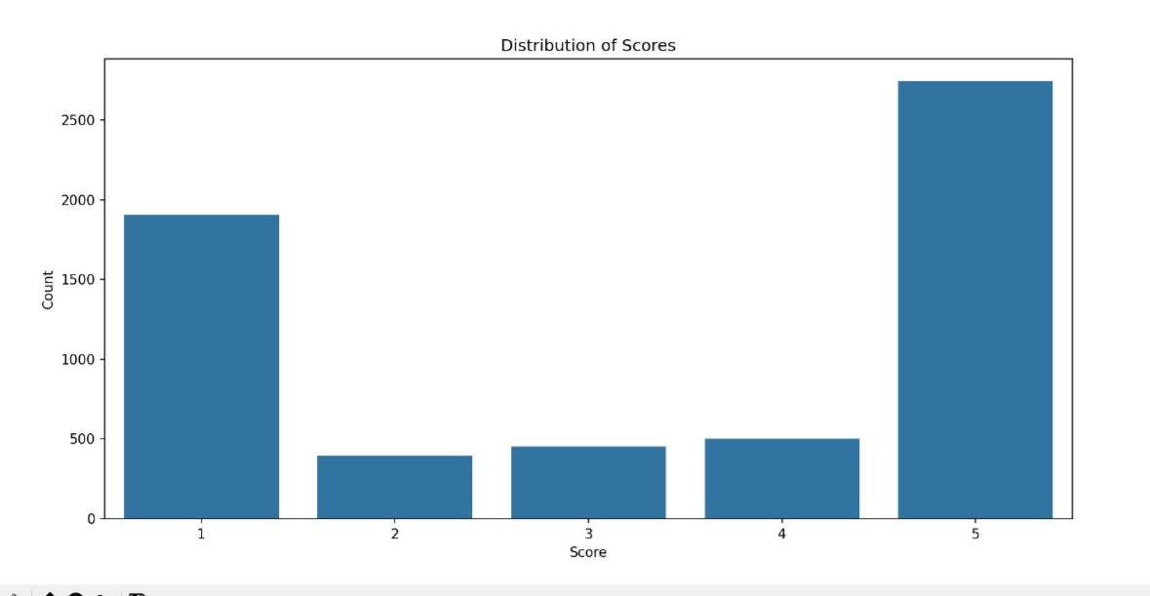
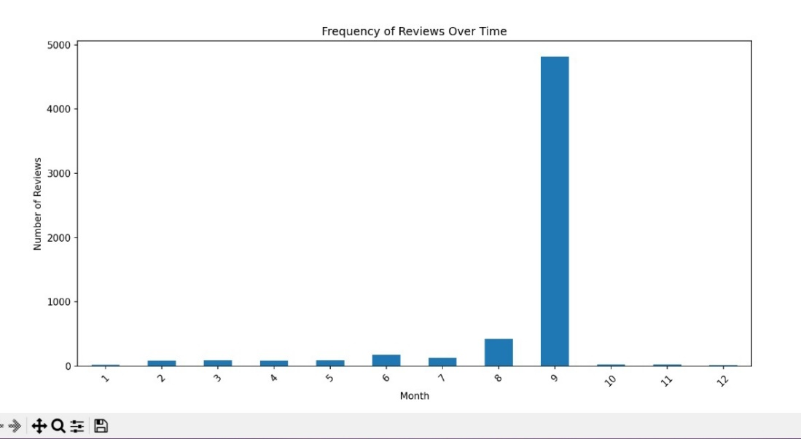
RESULTS
3/21/2024 Annual Review

Slide 12
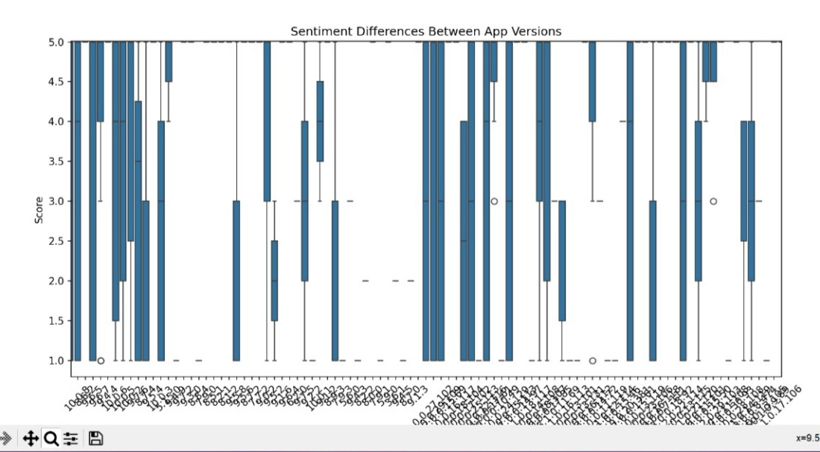
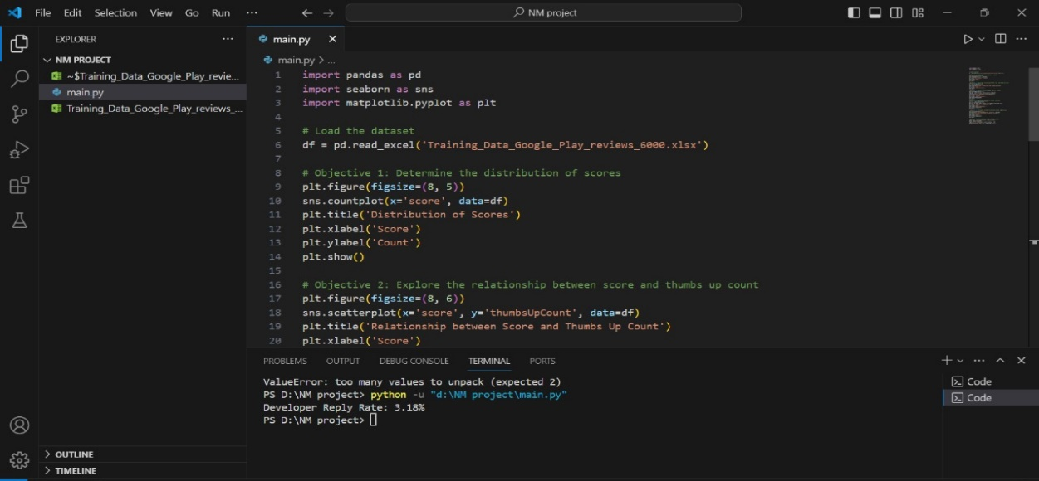
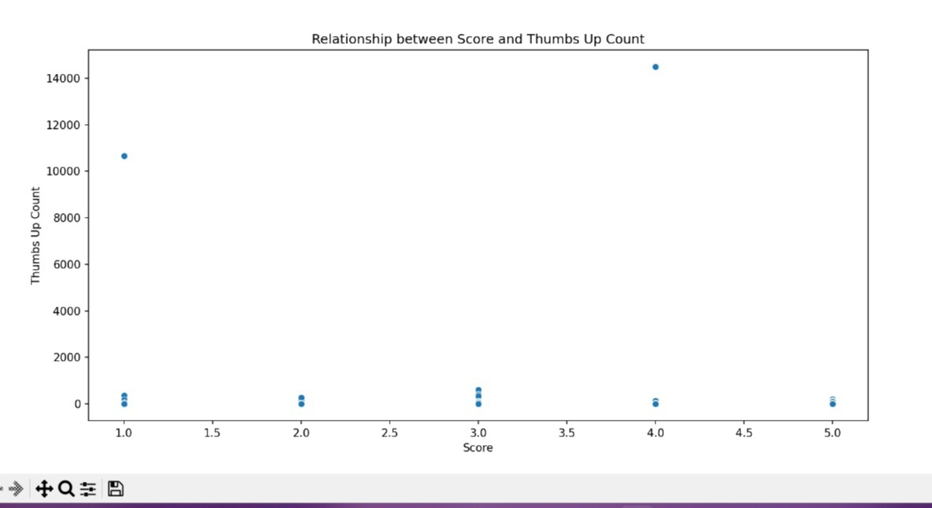
RESULTS

Slide 13
CONCLUSION
By leveraging app attributes and customer reviews, developers can uncover crucial factors influencing app engagement and success in the Android market.
Actionable insights derived from this analysis empower developers to refine their strategies, enhance user experiences, and effectively capture audience interest.
Through data-driven decision-making, app-making businesses can optimize their offerings, driving success and competitiveness in the dynamic ecosystem of the Play Store.

Slide 14
FUTURE SCOPE
Advanced AI-driven insights for tailored app enhancements, optimizing user engagement and market capture.
Seamless integration of real-time feedback loops, enabling agile app refinement and sustained success in the Android ecosystem.

Slide 15
REFERENCES
https://www.kaggle.com/datasets
https://pandas.pydata.org/pandas-docs/stable/user guide/index.html
https://seaborn.pydata.org/
https://matplotlib.org/stable/contents.html

